Slide 1
NODE JS
The Node.js run-time environment includes everything you need to execute a program written in JavaScript.

Slide 2
NodeJs – Install
Install Node
Nodejs.org
Download LST version
* LST (Long Term Support)
Current (Most recent updated version – Having latest features)
Download and install Node on computer
How to test Node is installed
Open CMD and type
Node -v
Test Editor
Visual Studio Code

Slide 3
NodeJs – Explore
Before Node, JavaScript could not used as general purpose programing language and limited to what the browser allow to do. Like to create click event on browser or to redirect browser from one link to an other.
JavaScript was not able to build web server to access file system etc. and connect to database
Node, allow the user to user JavaScript to do following
Build Web servers
Command line interfaces
Applications backbends and more…

Slide 4
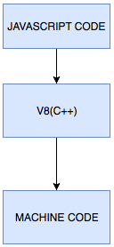
Node js
Node is a way to run JavaScript code on server as appose to run it on client browser
Node.js® is a JavaScript runtime built on Chrome's V8 JavaScript engine.
Any JavaScript engine works same
V8 is Google open source project (Written in c++)
Node is not an programming language, its runtime environment
Runtime That provider custom functionality
Tools and libraries specific to environment

Slide 5
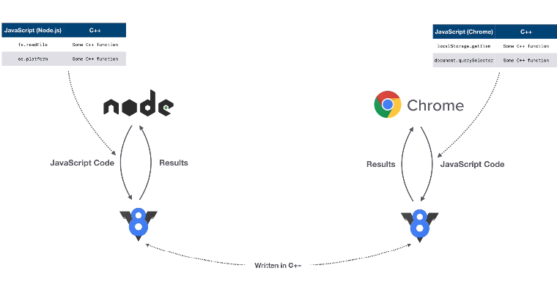
V8 JavaScript Engine and Node
Node and chrome both providing bindings when (node) initiating the v* engine which allow these to create runtime features
Like Chrome interact with DOM, as DOM is not a part of JavaScript
And node interact with file system as FS is not a part of JavaScript
Its up to chrome and node t provide implementation to V8 (JavaScript) of DOM and File system

Slide 6
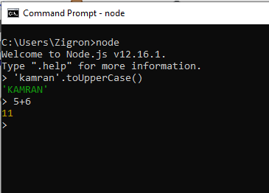
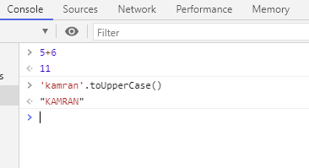
Commonalties and differences
Commonalities
Node and Chrome
All the JavaScript functions are available as these are provided by V8
3 + 3 = 6 or toUpperCase()
Differences
Node and Chrome
Use window command, as windows is command specifically provided by chrome runtime, this is some thing related to browser
Node use global similar to windows, which stores lots of values which can be used in projects
Process.exit to exit node terminal
REPL: Read evl print loop

